Slide 1
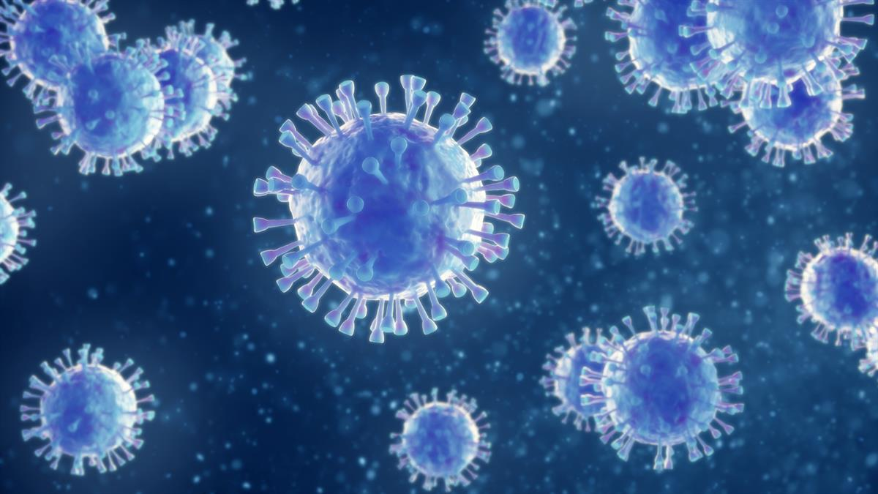
World After Covid-19
Efforts by
BHAVIKA DHINGRA

Slide 2
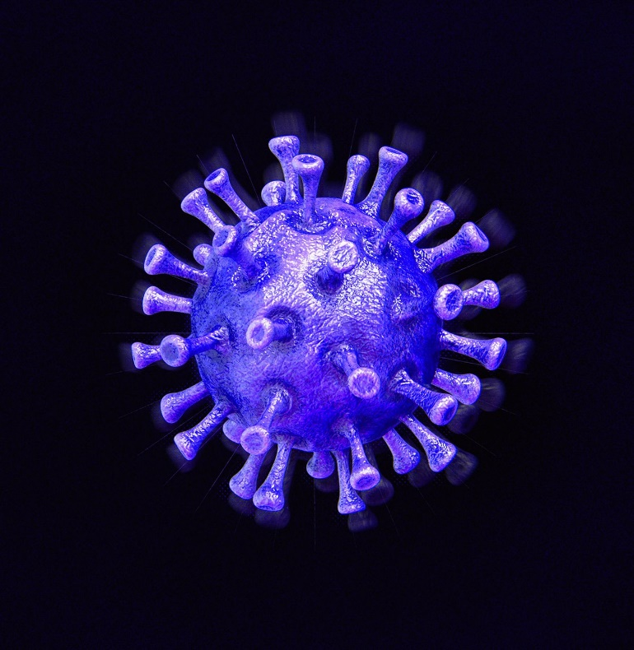
What Is covid-19 ?
COVID-19 is a disease caused by a new strain of coronavirus. 'CO' stands for corona, 'VI' for virus, and 'D' for disease.
SARS-CoV-2 is the name of the virus that causes COVID-19

Slide 3
Covid-19 Impacted on
1
Human economy
2
Humun Social life
3
Earth

Slide 4
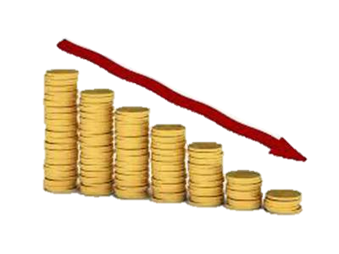

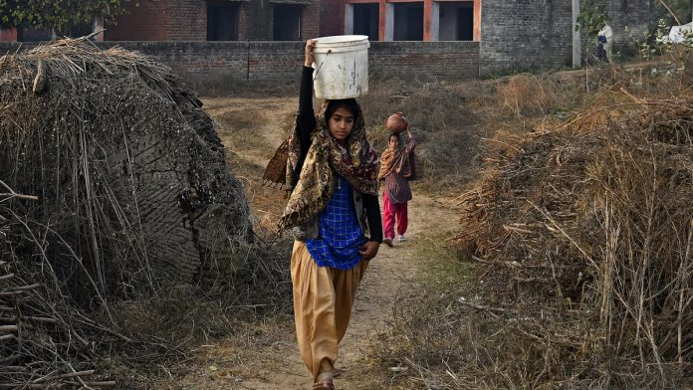
human economic and social Disruption
The COVID-19 pandemic has led to a dramatic loss of human life worldwide and presents an unprecedented challenge to public health food systems and the world of work.
The economic and social disruption caused by the pandemic is devastating: tens of millions of people are at risk of falling into extreme poverty, while the number of undernourished people, currently estimated at nearly 690 million, could increase by up to 132 million by the end of the year.

Slide 5
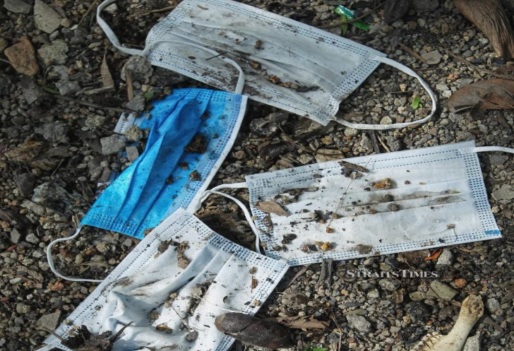
Garbage is increasing
since mask are made with non- biodegradable material it Is not easy to compost it
Garbage is increasing day by day
To prevent it we should always through the masks in the garbage and learn a prOper way to dispose of these masks

Slide 6
Quiz time!
What is covid-19?
None of the Above
Bacteria
Virus
WHAT IS ANOTHER NAME FOR COVID-19 ?
SARS-CoV-2
MEGAVIRUS
PLAGUE
STATE TRUE OR FALSE
Covid-19 is effecting human life.
True
False

Slide 7


